Slide 1

INSTALL AND CONFIGURE MySQL

Slide 2
1. Open up your browser and head over to mysql.com
2. Go to Downloads tab, scroll down to Select my community(GPL)

Slide 3
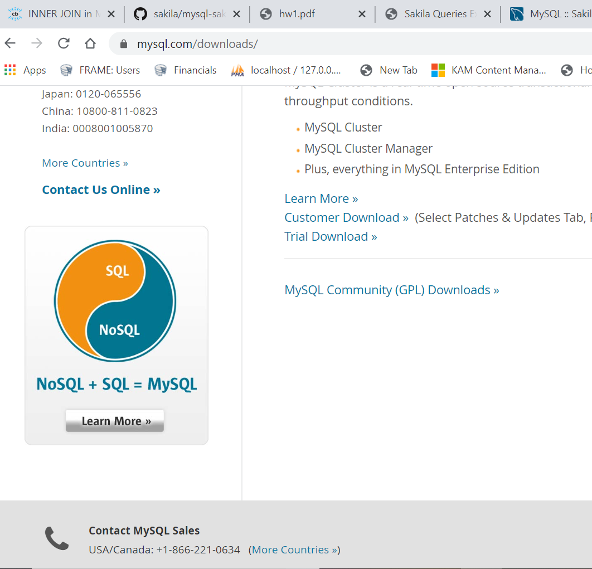
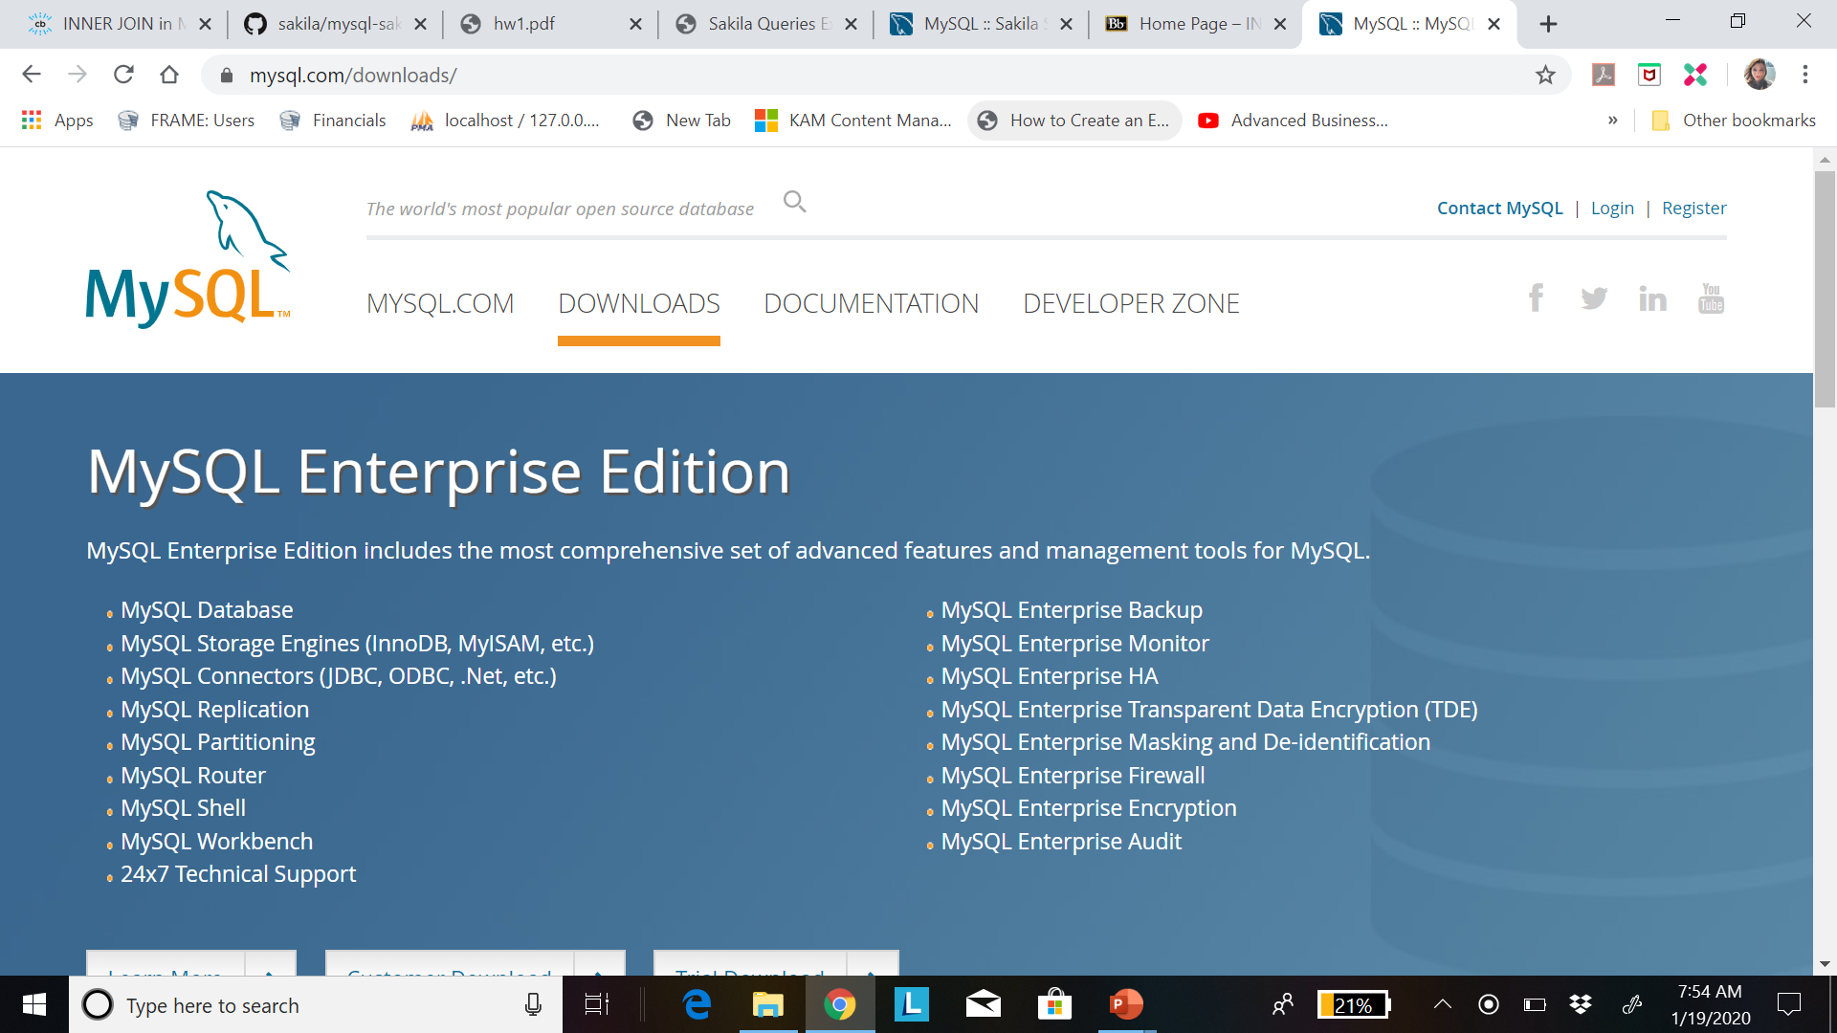

Slide 4
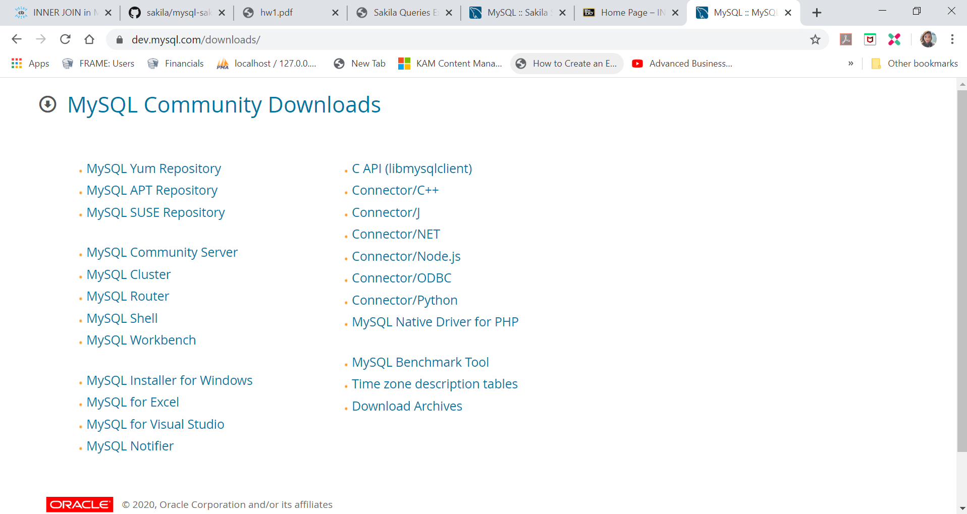
3. SELECT My SQL Community server

Slide 5
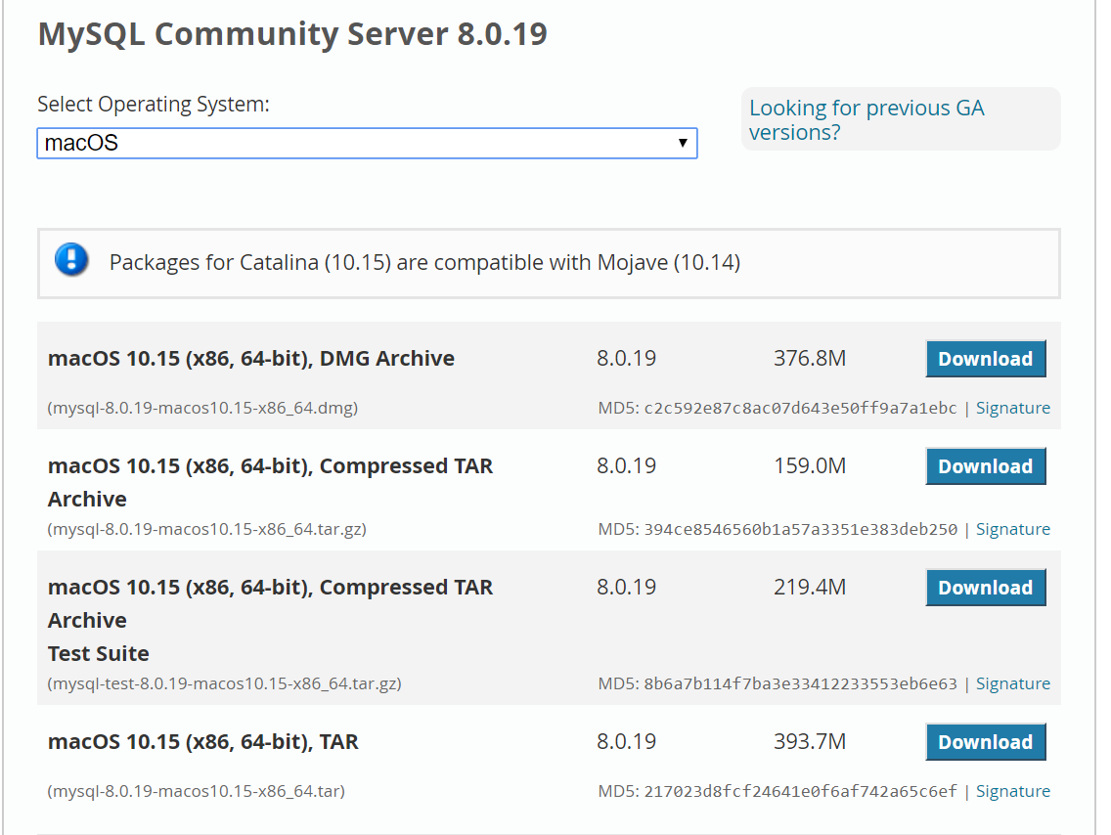
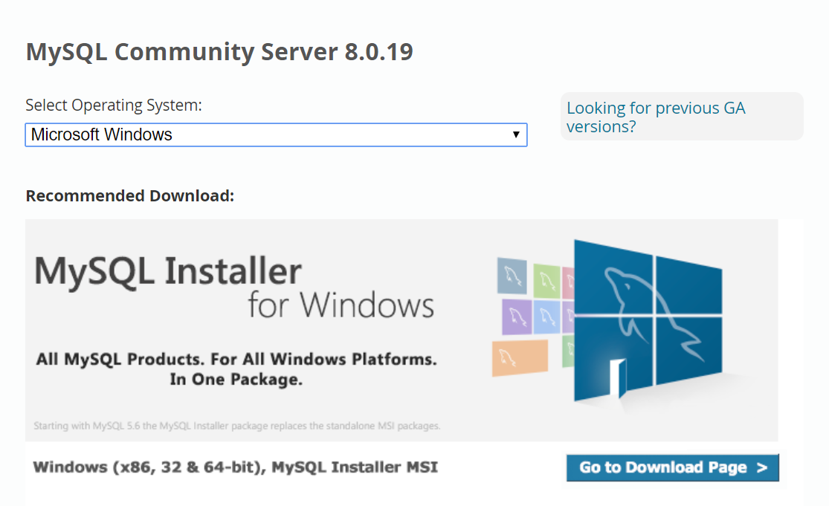
For Windows – MySQLInstaller
For Mac – DMG archive

Slide 6
Instructions for Windows

Slide 7
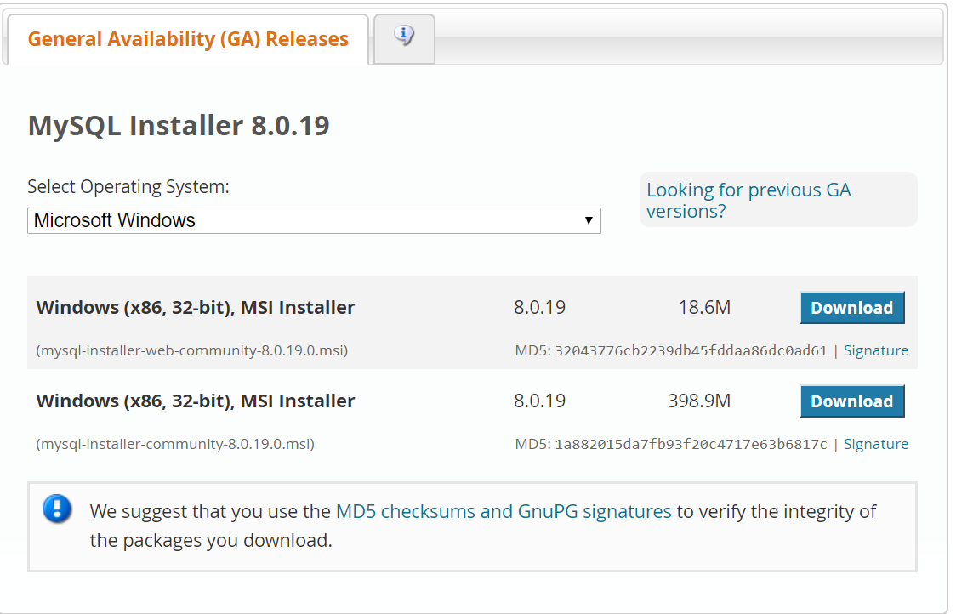
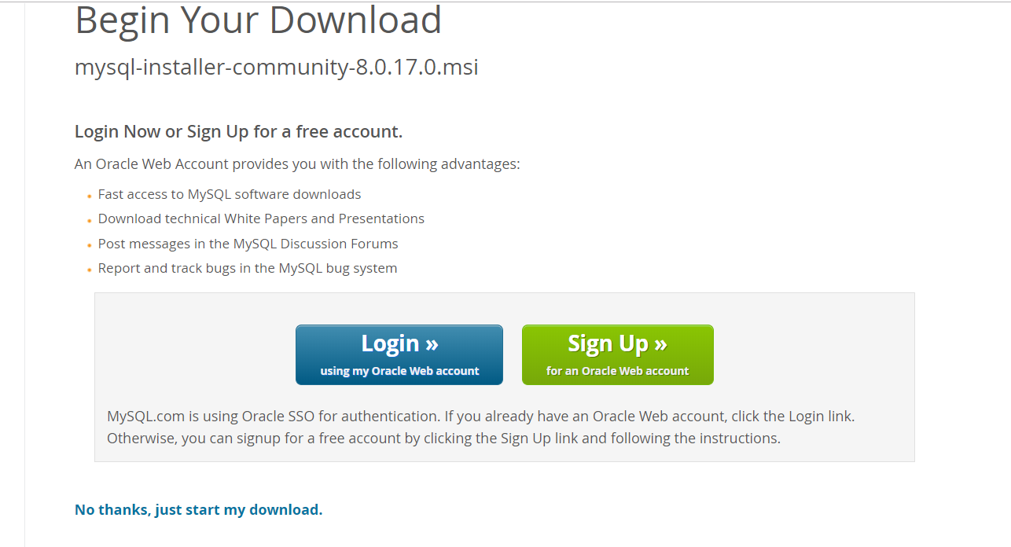
Download 32-bit Installer with greater file size which is direct MSI Installer

Slide 8
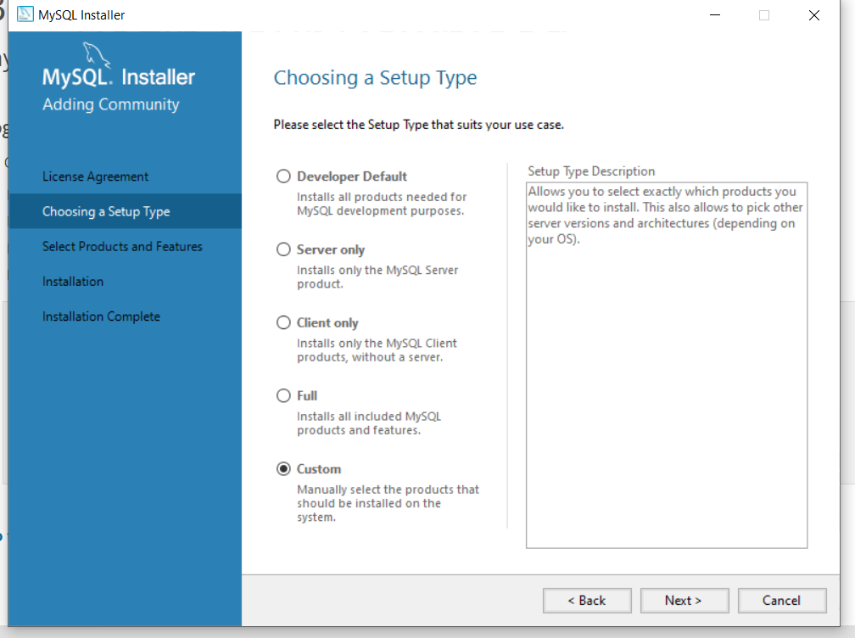
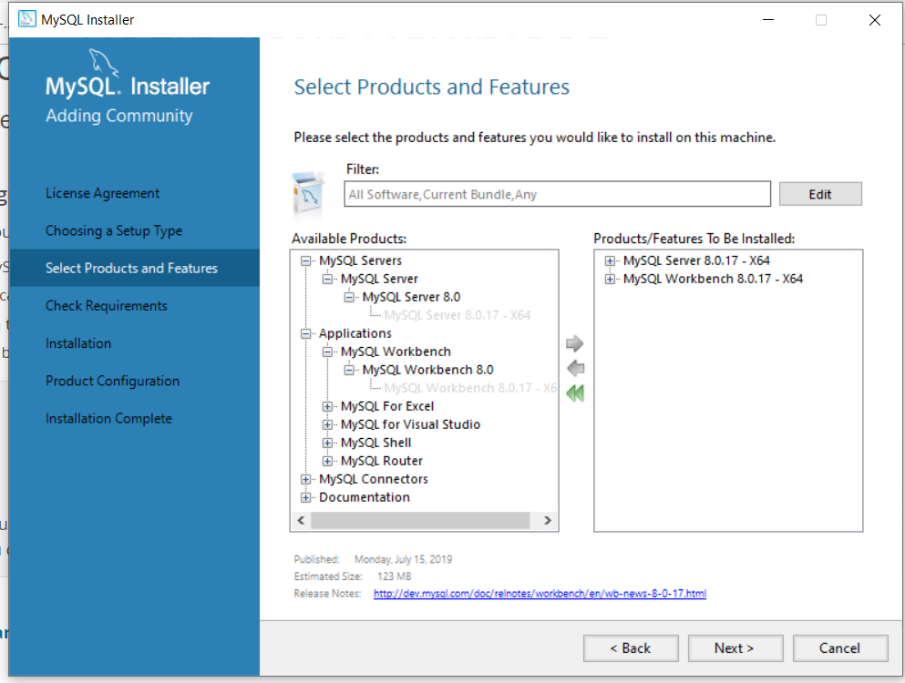
In the installation window after accepting the license check-box, Select Custom check-box in the
Setup Type window so that we can customize the product and path for mysql.
Select the appropriate MySql Server version and Application as shown in the right screenshot

Slide 9
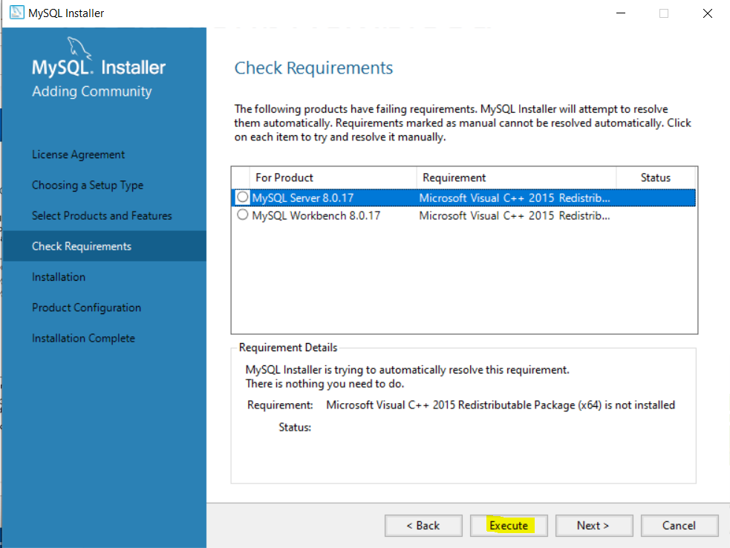
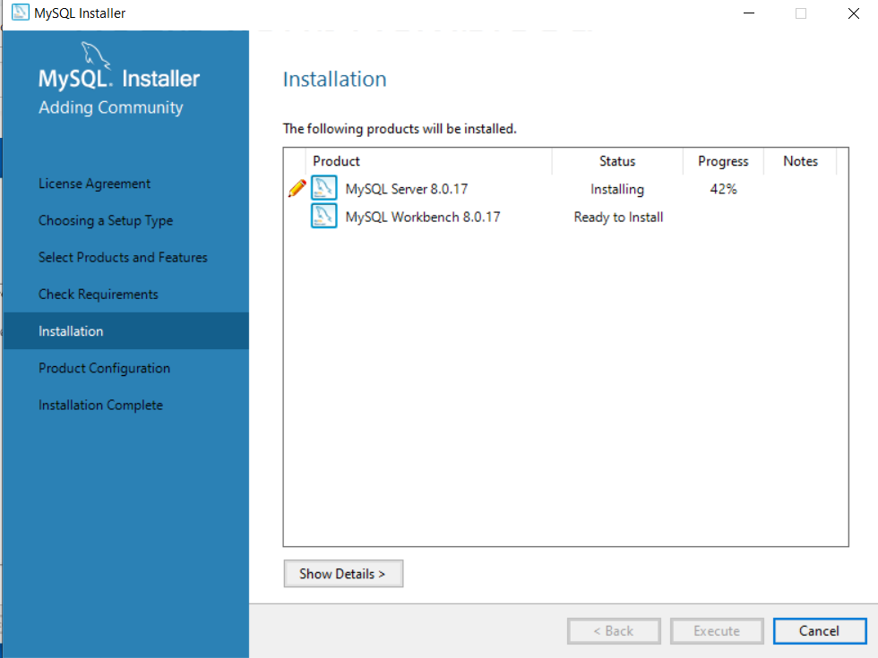
Depending on the pre-install softwares you may or may not install pre-required softwares.
Here in my case I have to install Microsoft Visual 2015 Redistributable package. Select the software and hit Execute button.
Once all the required software are installed successfully, you can now tart the installation of MySql Server and workbench.

Slide 10
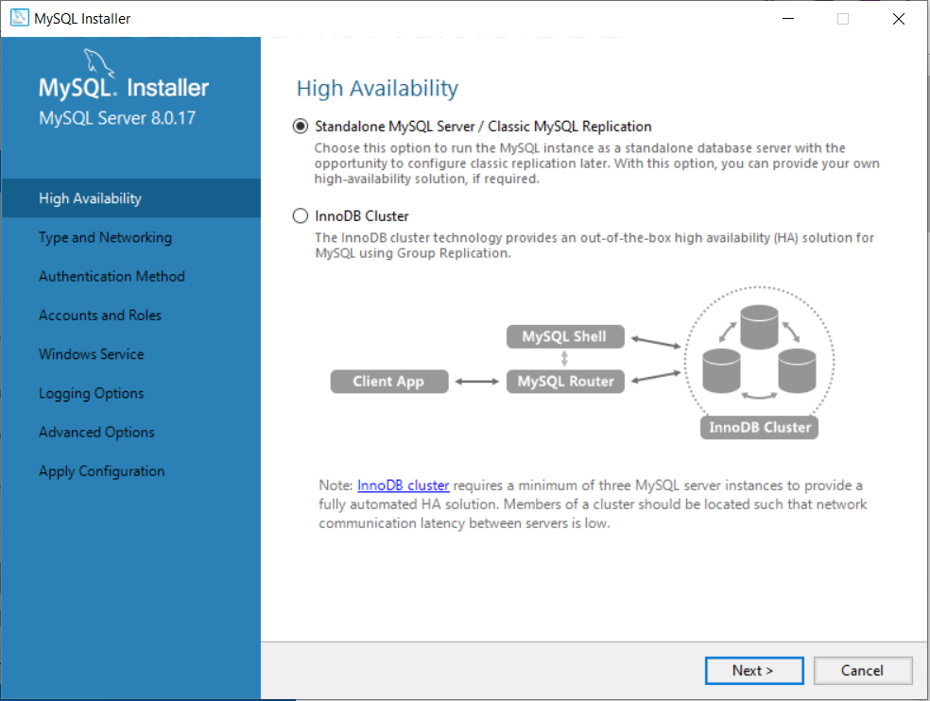
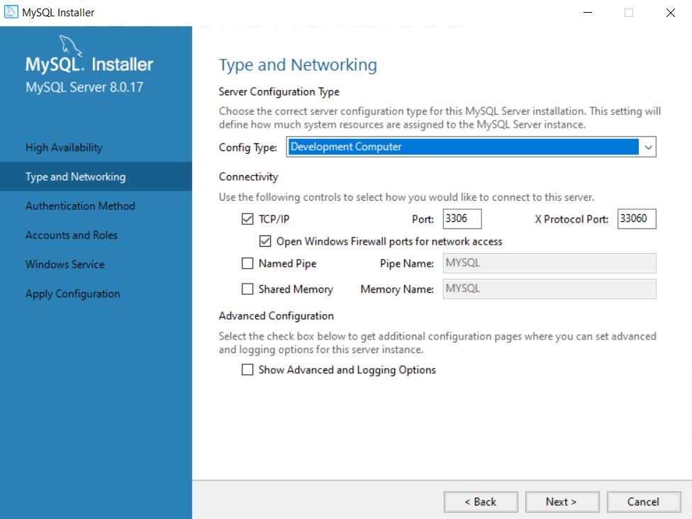
After starting with the configuration, select Standalone checkbox and then you can select the Port in Type Networking.
If port Number 3306 is already in use you can change the port no. to 3307.

Slide 11
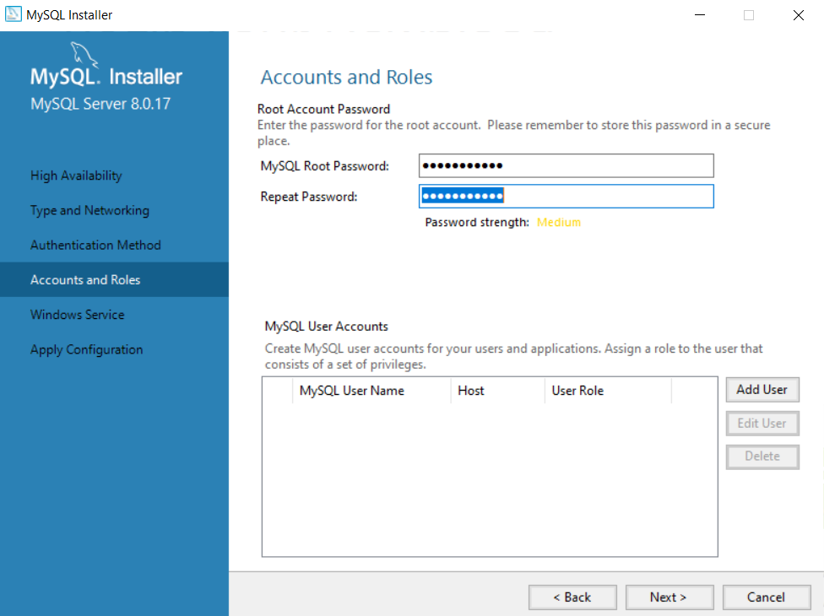
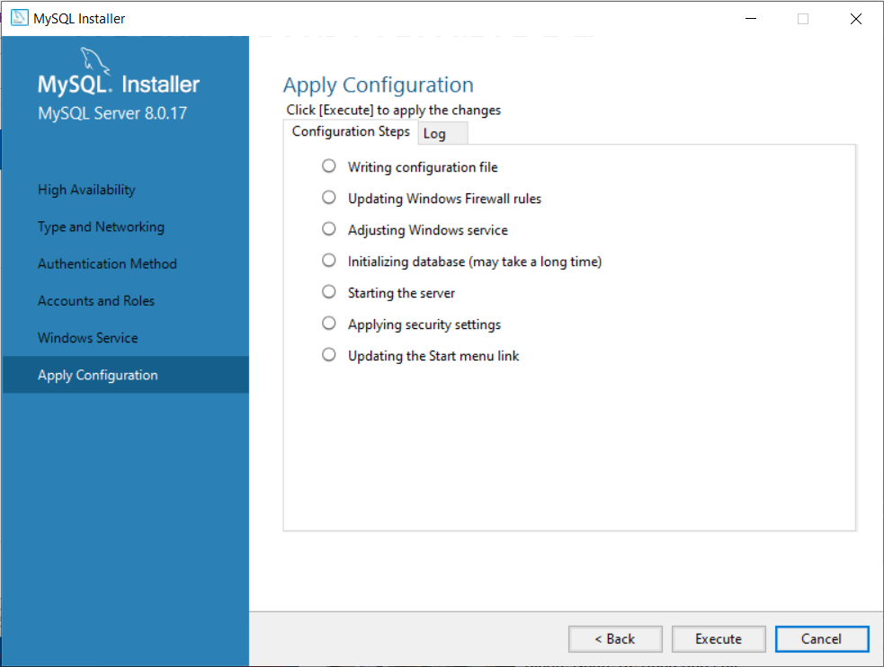
By Default MySQL creates a Root User which acts as an administer for all MySQL Databases and now
we require to set Root User password here.
Now Installer is ready to apply the configuration settings that we selected so far. Click the Execute Button and begin
using MySQL Server

Slide 12
Instructions for
Mac

Slide 13
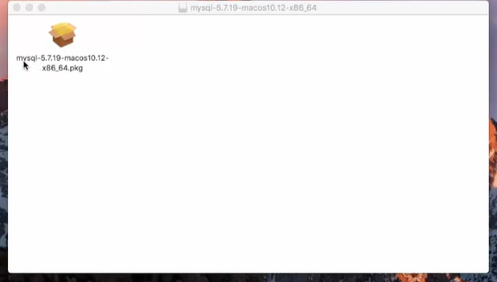
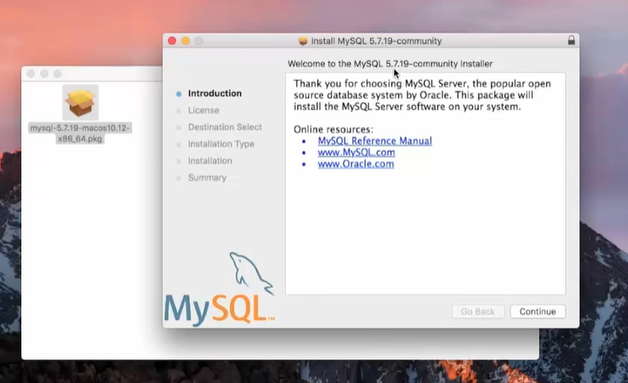
Double-click the .dmg file to start the installation process. Hit Agree button to accept the Terms and Conditions

Slide 14
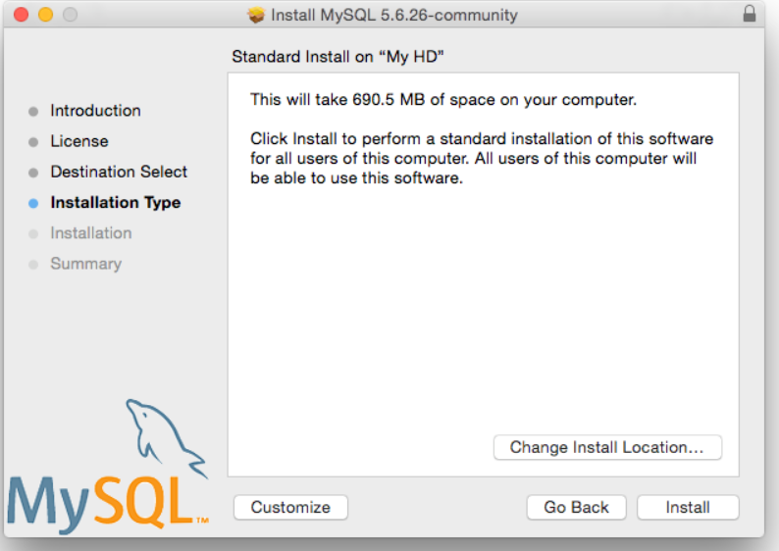
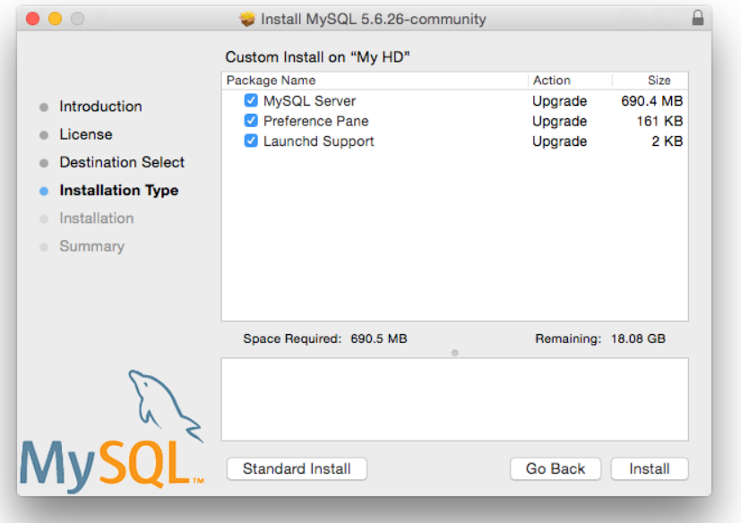
From the Installation Type page you can either click Install to execute the installation wizard using all defaults,
click Customize to alter which components to install (MySQL server, Preference Pane, Launchd Support).

Slide 15
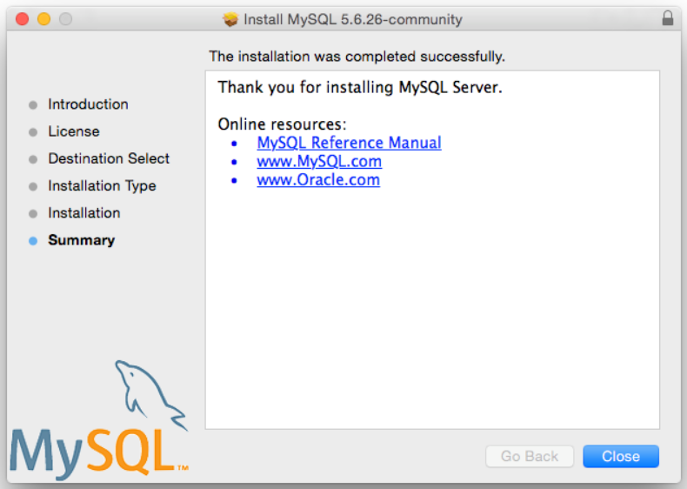
Once the installation has been completed successfully, you will be shown an Install Succeeded message.
Now, Close the wizard and begin using the MySQL server.

Slide 16
..this completes the installation

Slide 17
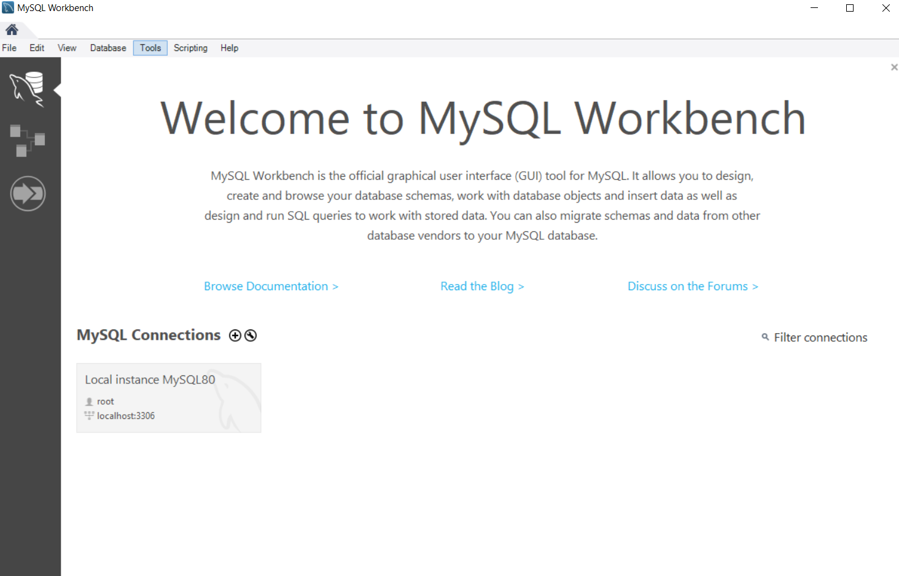
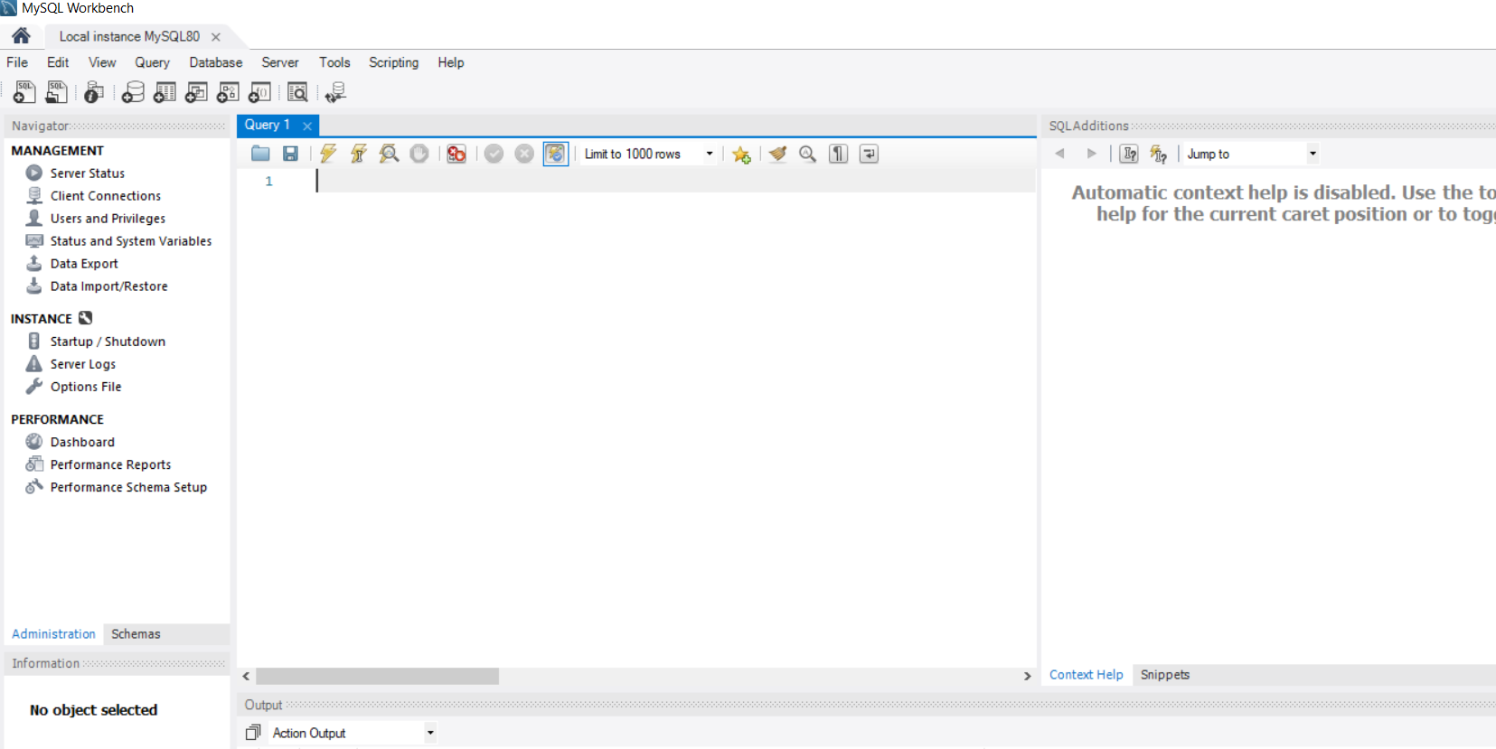

Slide 18
CONNECTION SETUP
Demo of how to create a connection
Click on plus icon – give your connection a name
Local host
Password : REMEMBER THIS!!!(P)

Slide 19
Practice Datasets
The Sakila and world sample database is available from https://dev.mysql.com/doc/index-other.html.
A downloadable archive is available in compressed tar file or Zip format.
Unzip them and open them with MySQL WorkBench
Run the .sql script

Slide 20
Thank You

